Slide 1


HOUSE PRICE PREDICTION
Through an exploration of the dynamic field of house price prediction, this study addresses the crucial issue of predicting property prices in the real estate market. Our research is aimed at creating a predictive model that will employ state-of-the-art machine learning techniques to detect the factors influencing property values and generate accurate predictions. Regression models like Ensemble, Decision Tree, and Linear Regression are used in conjunction with substantial data pre-processing and attribute management, including area, neighbourhood, and facilities.
by Disha Arora & Aadisha Aditi

Slide 2

Introduction
Real Estate Challenge
Predictive Model
Aim of Project
The real estate market is complicated and vulnerable to many factors, so anticipating and understanding fluctuations in property values requires proactive strategies.
Our objective is to precisely estimate house prices in a sector where several stakeholders depend on accurate property assessment.
Our project utilizes linear regression, decision tree and random forest to predict house price.

Slide 3

Model Selection and Training
1
Linear Regression
2
Support Vector Regression(SVR)
Random Forest Regressor
Decision Tree Regressor

Slide 4

Results(Linear Regression)
Reg. Score:
67.94071835586118
Results(SVR)
Reg. Score:
Confusion Matrix. [[942 95] [186 184]]
13.036335929017529

Slide 5
Results(Decision Tree Regression)
Reg.Score
66.33206157217968
Results(Random Forest Regression)
Reg. Score
82.46673877705297

Slide 6
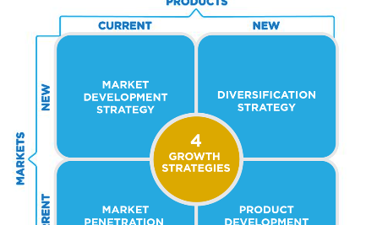


Conclusion
Proactive Approach
Valuable Insights
Reliable Prediction Source
Our House Price Prediction model is a useful and proactive tool for anticipating and controlling fluctuations in property values.
The model exhibits a high degree of predicted accuracy and offers valuable insights into the intricate factors influencing property prices through the application of state-of-the-art machine learning techniques.
The model provides a reliable source for home value prediction, which helps the real estate sector optimise its decision-making processes.

